Slide 1

D&D Optimal Combat Encounter
Alyssa Vellucci, Jonas Wagner
MECH 6326: Optimal Control & Dynamic Programming
Spring 2023

Slide 2
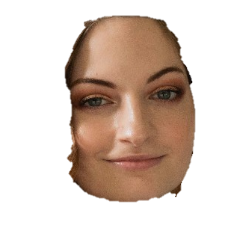



D&D Optimal Combat Encounter
Introduction
Problem & Model Formulation
Dynamic Programming
Numerical Experiments
Conclusions
DYNAMIC PROGRAMS
Notes:
alyssa

Slide 3
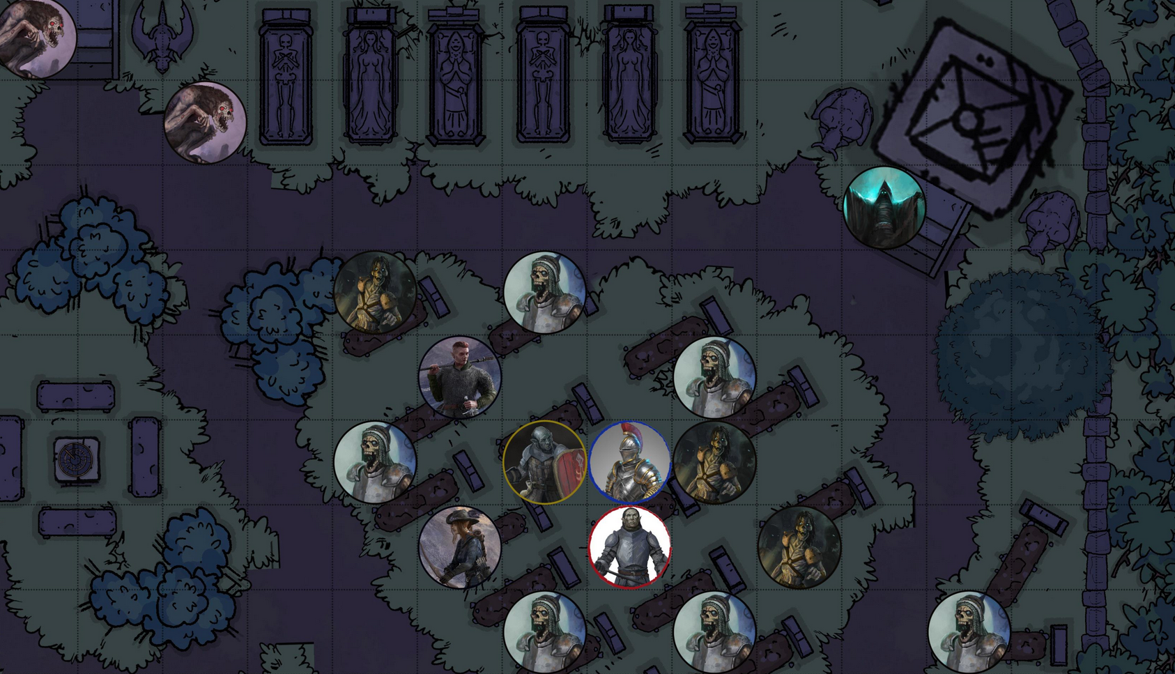
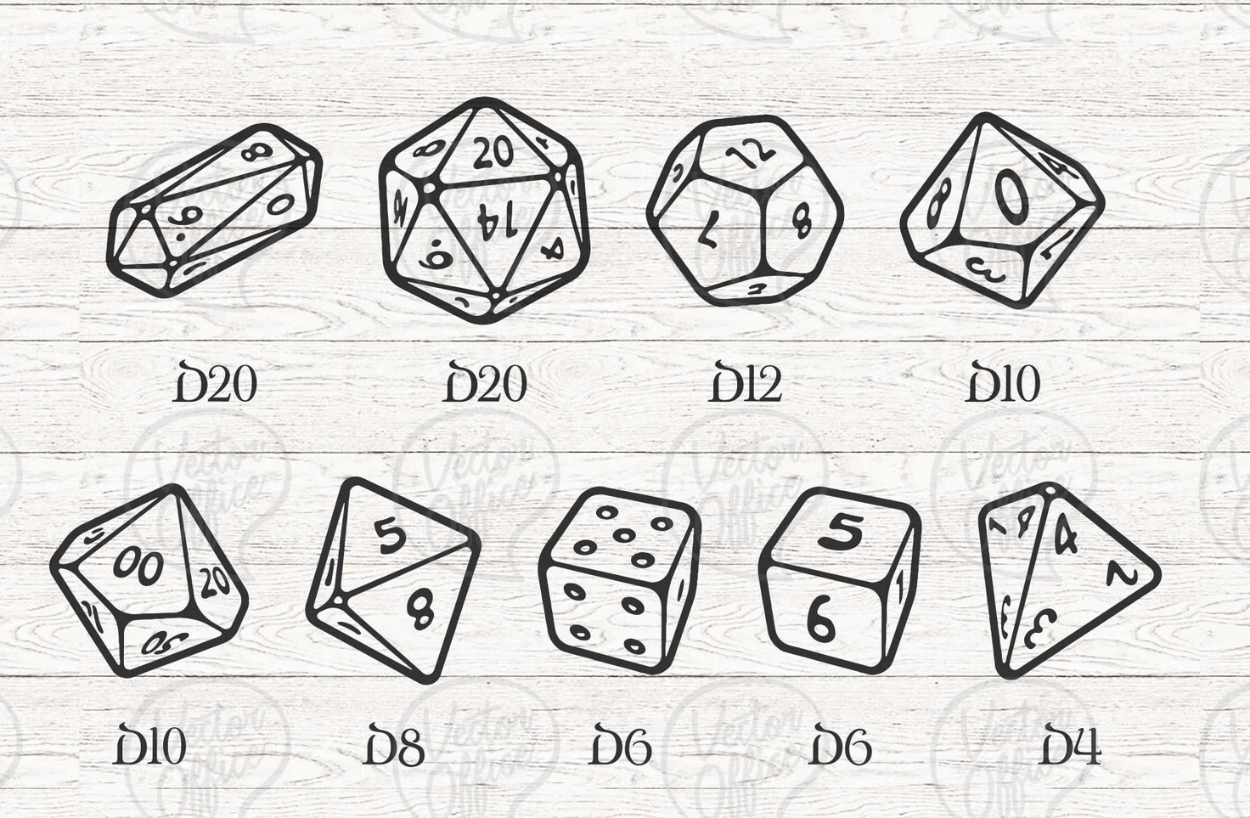
Introduction
D&D Optimal Combat Encounter
Dungeons & Dragons (D&D) is a tabletop roleplaying game.
Combat encounters consist of an enemy (monster) and player characters (PCs). The PCs want to defeat the monster and remain alive themselves. The success of their actions is determined by a dice roll.
General process for a combat encounter:
Player moves their PC on the battle-map
Player chooses an action to perform (weapon attack, health potion, etc.)
Player rolls required dice to determine the outcome of that action
Motivation: Given a dynamic combat scenario, what are the optimal actions to take to ensure that you don’t kill your character?
https://www.reddit.com/r/DungeonsAndDragons/comments/nozopn/free_vtt_token_generator_and_battle_maps_for_your/
https://www.etsy.com/listing/813121763/bundle-dnd-dice-svg-dungeons-and-dragons
Notes:
alyssa

Slide 4
D&D Combat → Problem Constraints
D&D Optimal Combat Encounter
D&D 5e Combat Rules | D&D Combat for Dynamic Programming
PCs can move at any point in their turn | PC moves at the start of their turn
PCs can move an amount equal to their “movement speed” per turn | PC moves one grid block per turn
PCs get a “bonus action” to allow them to cast spells, use class features, etc. | PC only gets one action (melee or ranged attack) and no bonus action
“Natural 20” is a critical strike + automatic hit, and a “Natural 1” is a critical fail + automatic miss | Natural 20 and Natural 1 rolls count as a regular success/fail
PC can interact with the environment (set traps, tie ropes, etc.) | Environment is flat, boundless, and has no objects to interact with
Footer information
Notes:
alyssa

Slide 5
Problem Formulation
D&D Optimal Combat Encounter
D&D Combat for DP Ruleset:
1 monster, 1 player character
Same weapon dice, health, and movement
Movement:
PC will move at the start of its turn, then perform an action
Monster will always move toward the player
Movement includes all cardinal directions
Combat:
PC and monster can perform one melee or ranged attack per turn
PC can perform one heal action, monster cannot heal
PC and monster can choose to do nothing on their turn
Footer information
Notes:
jonas

Slide 6
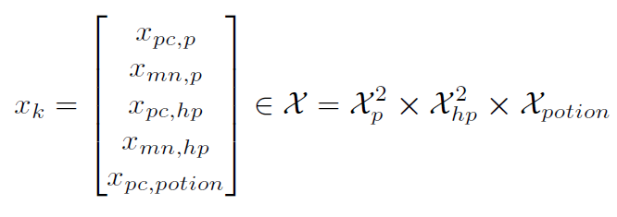
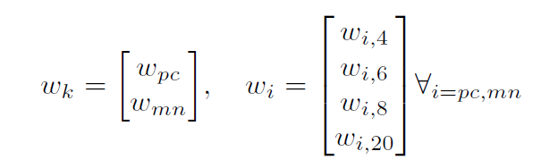
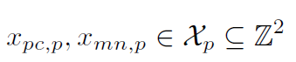
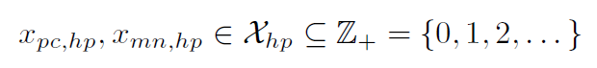
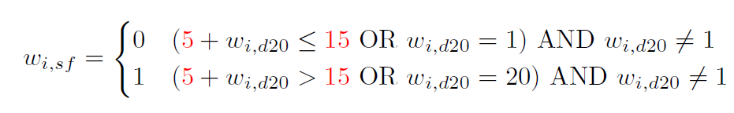
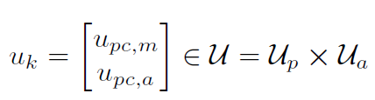
Model Formulation: State, Input, and Noise
D&D Optimal Combat Encounter
System States:
Current position of PC and Monster
Current HP of PC and monster
Potion availability (PC only)
System Inputs:
PC Direction of movement
PC Action
System Noise:
The dice rolls of the PC and monster are stocastic:
Each scaler noise value is the value of the associated dice roll
The derived success and failure of an attack:
The Success and Fail tests whether the d20 roll plus strength/dext are greater than the opponents AC
Notes:
jonas

Slide 7
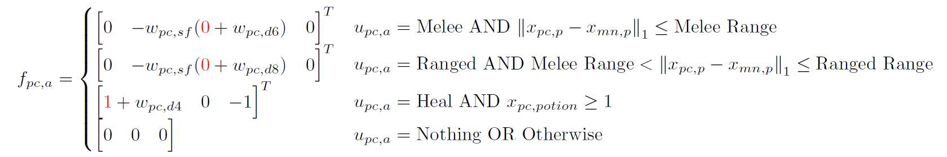
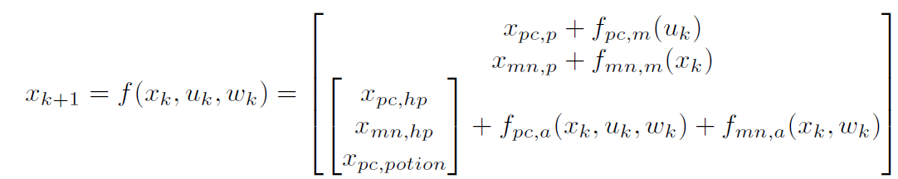
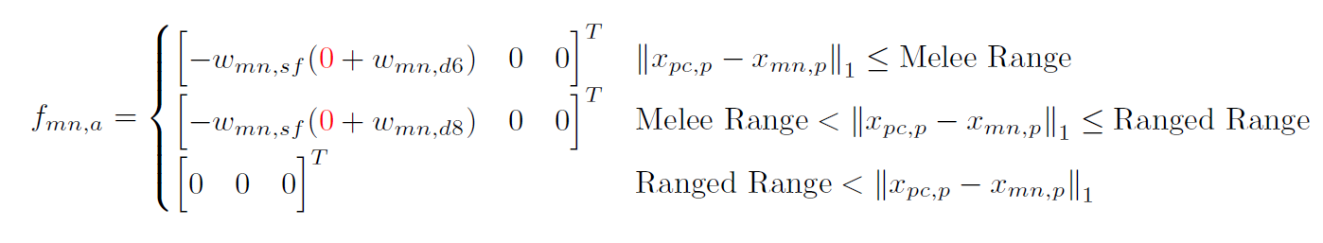
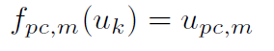
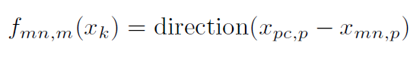
Model Formulation: State-Update Equations
D&D Optimal Combat Encounter
Actions
PC Action (dependent on input and within range)
Monster Action (only dependent on within range)
No weapon modifiers for PC or monster
Dice roll +0 for melee and ranged attacks
Attack ranges:
Melee: 1 block
Ranged: 2 blocks
State Update Equation
Movement
PC movement is a deterministic input
Monster always moves in the direction of the PC
Notes:
jonas

Slide 8
Dynamic Programming Process
D&D Optimal Combat Encounter
Define relative Markov Chains for each action given problem parameters
This is derived as a different Markov chain for each action applied alongside the success\failure
Compute “absolute” Markov probability matrices for the inputs at each location of the 5D grid
5D-grid is of relative position, PC and monster HP, and “have potion”
This computes a 5D sparse array for every position in the grid representing the probability of which states it could move to
Use MDP implementation on an infinite* time-horizon to determine the optimal input to maximize the objective function
The objective function consists of the PC HP at each point of the grid and a strong incentive to kill monster and stronger disincentive to dying
* Finite-time horizon implementation with k=N >> expected simulation time
Notes:
jonas

Slide 9
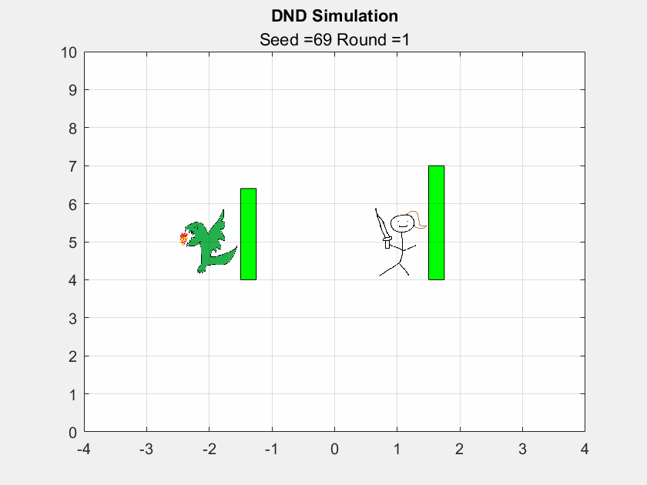
D&D Optimal Combat Encounter

Slide 10
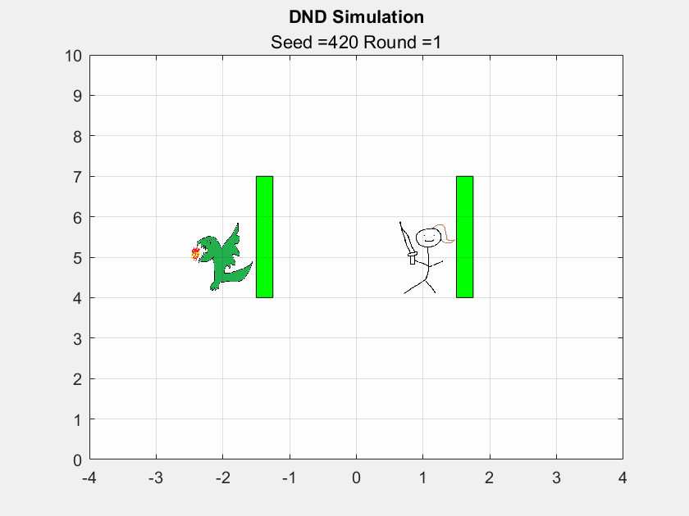
D&D Optimal Combat Encounter

Slide 11
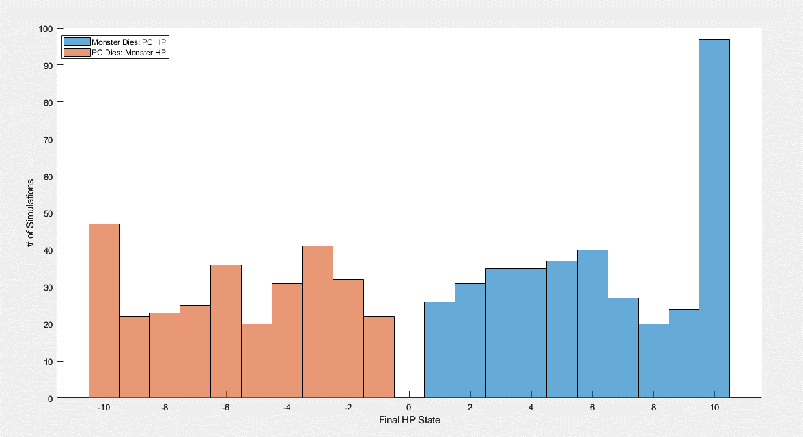
Monte Carlo Results: AMD
D&D Optimal Combat Encounter
This chart shows the HP of the PC and monster at the final state at the end of the simulation in the cases where one actor dies (PC or Monster)
Overall, the dynamic program produces a ~70% winrate over 1000 matches
Notes:
alyssa

Slide 12
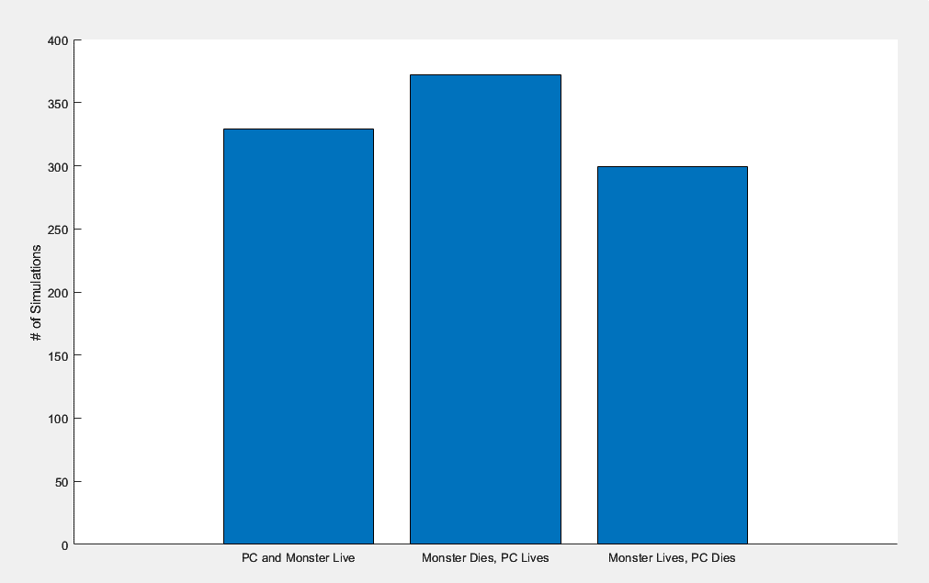
Monte Carlo Results: AMD
D&D Optimal Combat Encounter
Since we are maximizing just the player HP, there are some cases where the PC does not die, but does not kill the monster either
372
329
299
~40% of the time, the PC lives while killing the monster. ~30% of the time, the PC dies, and ~30% of the time both actors survive
Notes:
alyssa

Slide 13
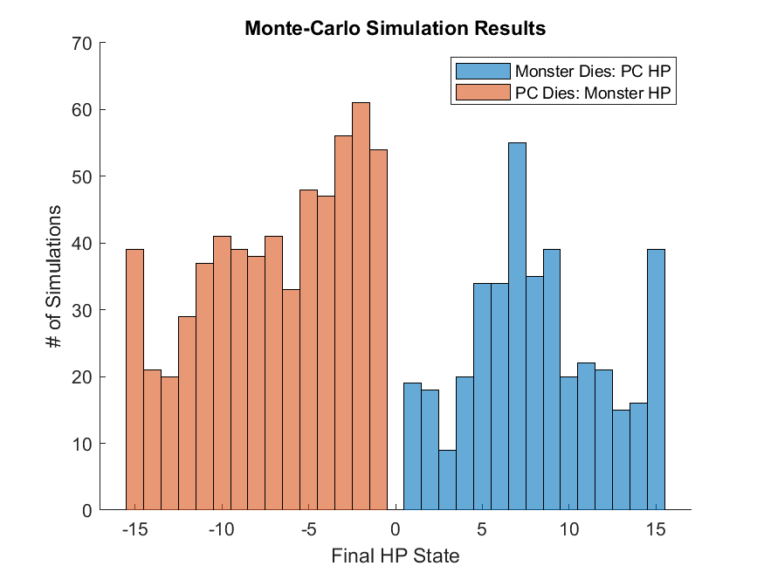
Monte Carlo Results: Intel
D&D Optimal Combat Encounter
Notes:
alyssa

Slide 14
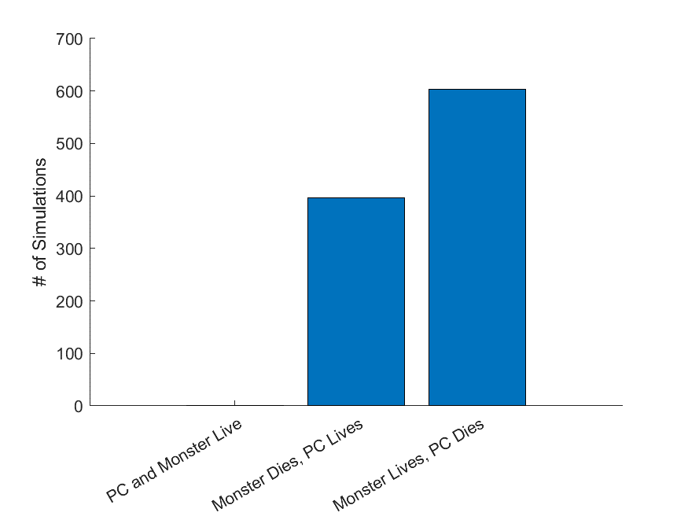
Monte Carlo Results: Intel
D&D Optimal Combat Encounter
604
396
Notes:
alyssa

Slide 15
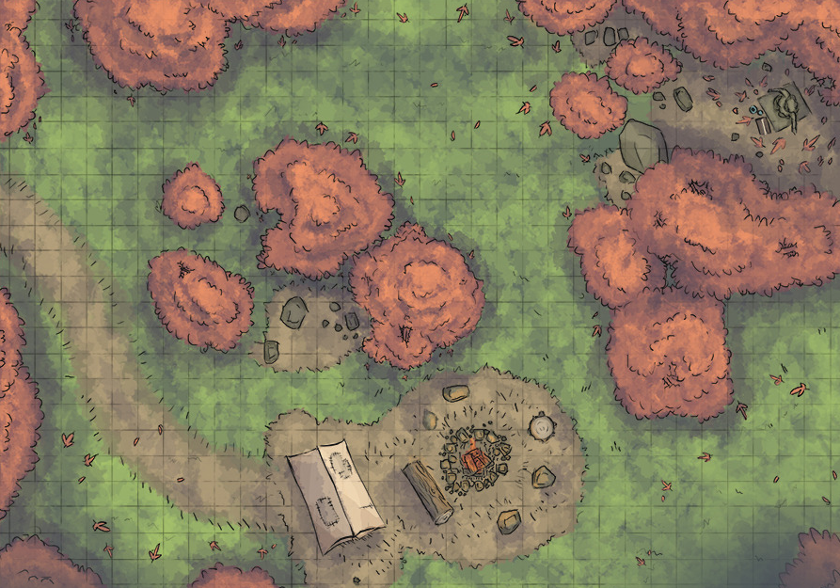
Future Work: Extensions
D&D Optimal Combat Encounter
Implement more directions than just N,E,S,W
Human Comparison Analysis
Experiment with stochastic monster movement
Include “difficult terrain” or obstacles
Footer information
Notes:
alyssa

